Slide 1
COSC 22035
Group Project
Group 10

Slide 2

Group Members
1. PS/2014/304 D.D.W. DISSANAYAKE
2. PS/2104/002 P.M.D.S. AMARASOORIYA
3. PS/2014/220 E.G.C. D. WATTEWA
4. PS/2014/072 G.R.L. AMARATHUNGA
5. PS/2104/051 A.A.A. SELAKE
6. PS/2014/297 W.A.D. MADURANGA
7. PS/2014/277 K.M. WANIGATHUNGA
8. PS/2014/213 J.A.D.V. SIRIWARDHANA

Slide 3

What is a Stock Management System ???
Stock Management System is software which is used by various business stuffs.
Used to manage stock of products.

Slide 4
There are four main modules in a stock management system.
Product Management
Purchase Management
Sales Management
User Management

Slide 5
Usually what happens in a Store…
Customer enters the store.
If the customer is new to the store ,customer is registered using sub GUI . Then/or not a new customer cashier uses GUI to order and check for items to fulfil the necessity.

Slide 6
Difficulties

Slide 7
Difficulty 1
A customer asks for an item but has not decided quantity yet . Just after another customer enters and asks for a particular quantity of the same item that previous customer asked.
But , 1st customer should be given the first priority.
Second cashier can not issue items for the next customer.

Slide 8
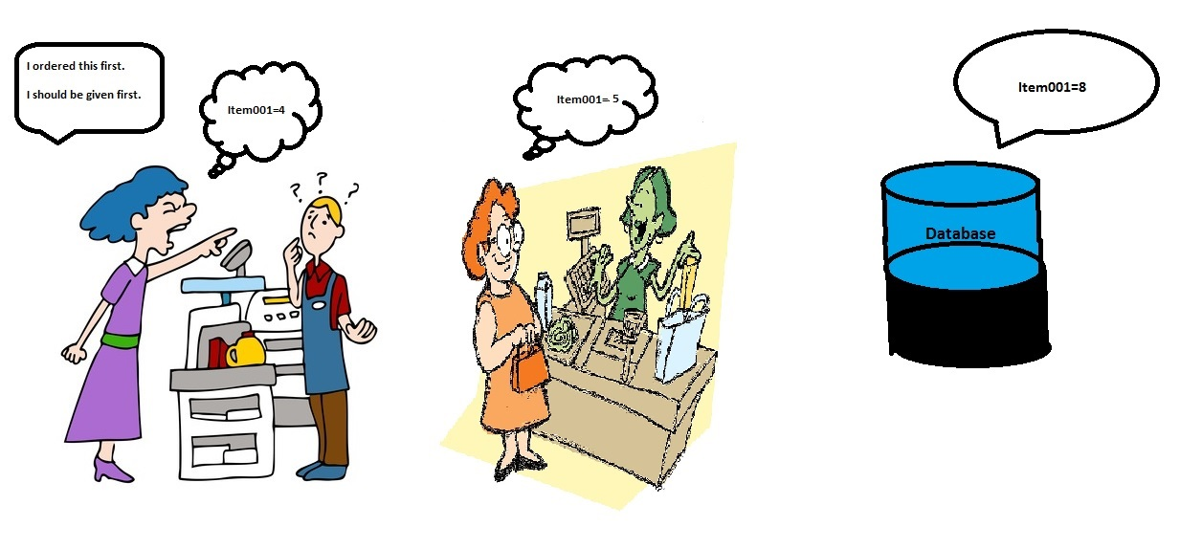
Item01=5
Item01=8
Item01=4

Slide 9
Difficulty 1 Solution
As soon as the first customer chooses to buy a particular item , program lock the data about that item.
Second customer cannot choose or see the data about the particular item.
First customer 1st priority is satisfied.

Slide 10
Problems Arise with that solution…
Difficulty 2
Second customer will have to wait until the first customer is done.
Long queues occurred.
Customers get angry and frustrated with the service.

Slide 11
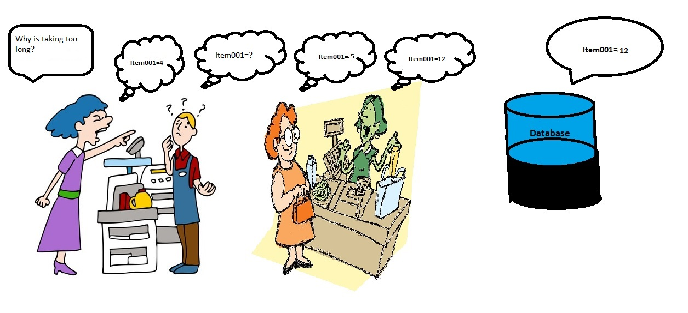

Slide 12
Difficulty 2 Solutions
Instead of waiting for the first customer to do the whole purchase , as soon as the first customer chooses a particular quantity in particular item , program updates the item’s data in database.
Then the second customer will not have to wait for a longer period as mentioned before.

Slide 13
Problems arises with solution…
Difficulty 3
Second customer asks for a bigger quantity of the same item that is not sufficient in the stock after previous purchase.Then the first customer decides to decrease the quantity or remove item , giving the chance to second customer to buy the item.
So cashier has to change the database again.

Slide 14
Difficulty 3 Solutions
Introduce a static variable stored in the RAM , not in the database.
Static variable equalizes it’s value to the particular quantity value in the database.
As soon as the first customer choose a particular quantity in an item , the value of the static variable decreases.
The quantity of the item in database decreases , only if first customer saves his purchase.
Database value is not harmed.

Slide 15
Demonstration

Slide 16
Questions ???

Slide 17
Thank you !!!

